Slide 1
Robot based Automation for Vertical Farming
Presented by:
POOLA ROHITH

Slide 2
Problem Statement
Due to the rapid growing rate of world population, farmers will face problems to keep up with demand.
Also, recent statistics have proved that 67% of water used in agriculture is going waste.
Vertical farming is also a better idea along with soilless farming techniques.
But in implementing and maintaining the vertical farms there is a huge requirement of labour and skilled workers

Slide 3
Introduction to Idea
Vertical farming is the practice of growing crops in vertically stacked layers with controlled environment.
It aims to optimize the plant growth and implementation of soilless farming.
Hydroponics involves growing plants by using mineral nutrient solutions in an aqueous solvent and uses 90% less water than in traditional agriculture.
Automation of Vertical Farming using hydroponics will be a powerful solution as it is more reliable and feasible.

Slide 4
Research gap
No related prior works are reported on robot based automation of vertical farming to the best of authors knowledge .
Most of the recent works focused only on the plant growth monitoring and conditioning.
Complete automation of vertical farming which involves planting, inspection, harvesting etc., are not implemented till date as per the literature.
End effectors developed for harvesting can only be used for specific products.

Slide 5
Objectives
Main objective is to Automate the process of vertical farming.
Minimizing human intervention in vertical farming.
Minimizing the utilization of water, requirement of pesticides
Maintaining controlled environment

Slide 6
Deliverables Required
Development of a 4 DOF mobile robotic manipulator for performing farming tasks in the vertical farms
Automation of the manipulator by implementing Artificial Intelligence
Opting for soilless agricultural techniques - Hydroponics.
Development of multi purpose end effector.
Implementing lift for accessing upper stacks.

Slide 7
Assumptions and Constraints
This solution can only be implemented to the plants which can be grown using hydroponics. It is not applicable to the plants of root vegetables (that grow underground).
The major constraints are:
Height of the plant (< 1m)
Size of the Fruit/Vegetable (diameter < 6 cm)

Slide 8
Risks on the project
It can only be implemented to the plants that are under the specified constraints.
Development of controlled environment
Dataset collection for vegetable detection and segmentation which are not available in open source
Implementing depth perception and mapping in real time application.

Slide 9
Scope of the Project
Automation of Vertical Farming has wide range of implementation.
It can be implemented in the areas with water scarcity, less fertile lands, deserted areas, etc.
As there is Minimum/No human intervention there necessity of labour is reduced to a great extent.
One of the most important application of the autonomous vertical farming is in Space missions.

Slide 10
Advantages
Most of the recent works in this field focused on the plant growth monitoring and conditioning.
The Closest solution implemented for the same problem is automation with Cartesian manipulators attached to each stack which will be very expensive and complex for maintenance.
Our idea is implementing a Serial mobile manipulator for performing all farming activities such as planting, inspection and harvesting.

Slide 11
Methodology Schedule
Development of conceptual design for overall project
1 Sep – 15 Oct
11 days
Analysis and optimization of the design
1 Oct - 15 Nov
0%
21 days
Creating virtual environment and performing all required virtual simulations. Development of required AI/ML algorithms
0%
73 days
1 Nov - 9 Feb
0%
41 days
0%
Fabrication of the Robot and Vertical farming environment
15 Jan - 28 Feb
44 days
0%
Robot control and automation. Implementation of developed algorithms in fabricated model
22 days
1 Mar - 30 Apr
0%
Preparation of manuscripts and documentation
1 May - 31 May
2021
2022
Sep
Oct
Nov
Dec
2022
Feb
Mar
Apr
May
2022
Sep
Oct
Nov
Dec
2022
Feb
Mar
Apr
May

Slide 12
Budget with justifications
Items required | Amount | Justification based on the outcome expected
G.I pipes | 3000 | Table & lift frame
Aluminum extrusions | 5000 | Table frame
Wood floor | 1000 | Table base
PVC parts | 1000 | Planting environment & Water storage
Couplings, Leadscrews | 2000 | Manipulator & lift
Hydroponics | 10000 | Nutrient solution
Notes:
Prepare the budget with stringent control that can be exercised to have minimal use of fund for achieving the objectives. Please remember that the money is internally generated revenue and hence very sparingly to be used. Guide(s) have to take utmost care while preparing/finalising the budget.

Slide 13
Budget with justifications
Items required | Amount | Justification based on the outcome expected
Motors | 24000 | Manipulator, lift
Motor drivers | 10000 | Motors used
PCB | 4000 | -
Camera | 5000 | Vision & Inspection
Jetson TX2 | 20000 | Computation
LiPo Batteries | 10000 | Power Source
Other consumables | 5000 | Fabrication
Contingency | 20000 | -
TOTAL | 120000
Notes:
Prepare the budget with stringent control that can be exercised to have minimal use of fund for achieving the objectives. Please remember that the money is internally generated revenue and hence very sparingly to be used. Guide(s) have to take utmost care while preparing/finalising the budget.

Slide 14
Stipend Used
Items required | Amount | Justification based on the outcome expected
Motors | 20000 | Manipulator
Motor drivers & Encoders | 5000 | Motors used
Aluminum Extrusions | 4000 | -
Arduino Mega | 2000 | Controller
TOTAL | 31000
Notes:
Prepare the budget with stringent control that can be exercised to have minimal use of fund for achieving the objectives. Please remember that the money is internally generated revenue and hence very sparingly to be used. Guide(s) have to take utmost care while preparing/finalising the budget.

Slide 15
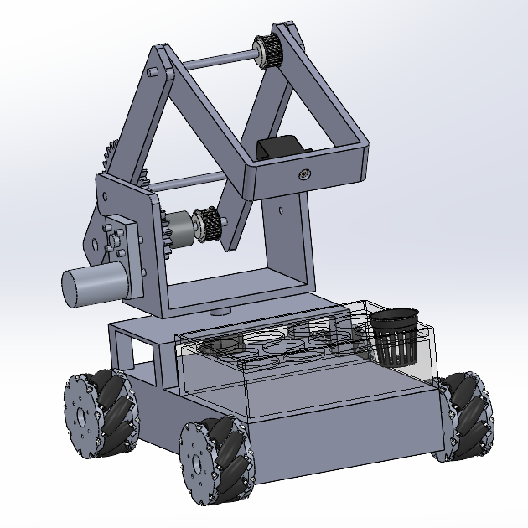
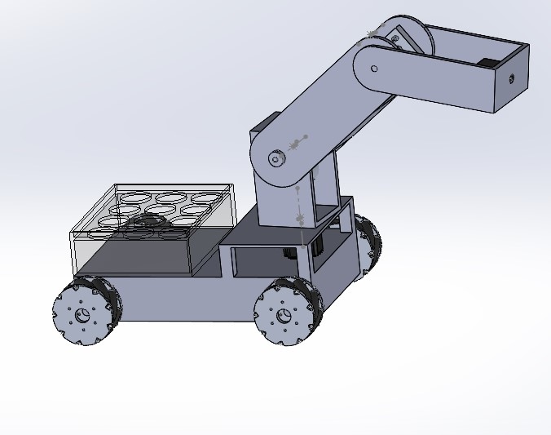
Design Diagram - Manipulator
MODEL - 1
MODEL - 2

Slide 16
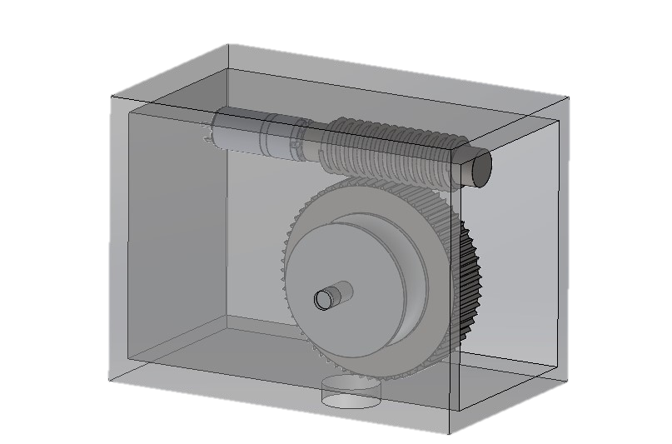
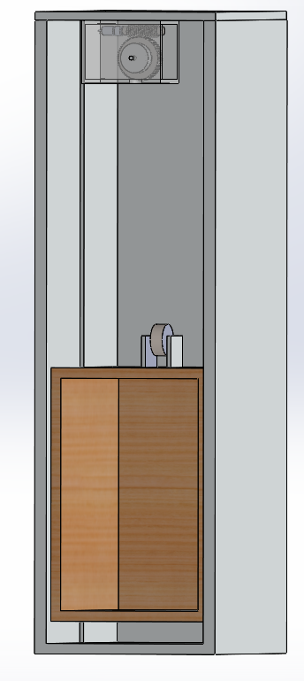
Design Diagram - Lift
Platform actuation by motor with worm and spur gear mechanism

Slide 17
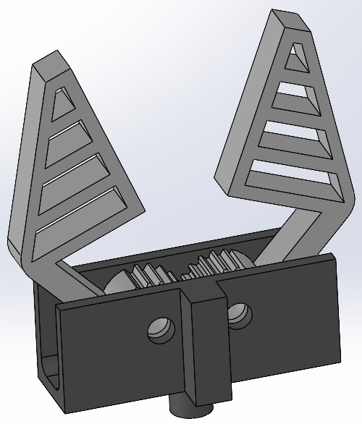
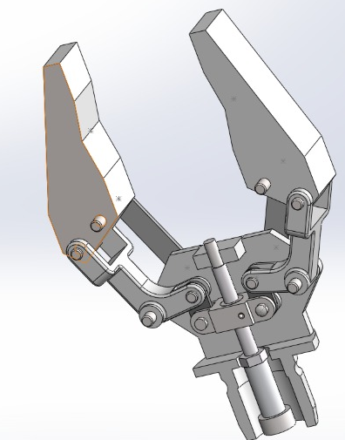
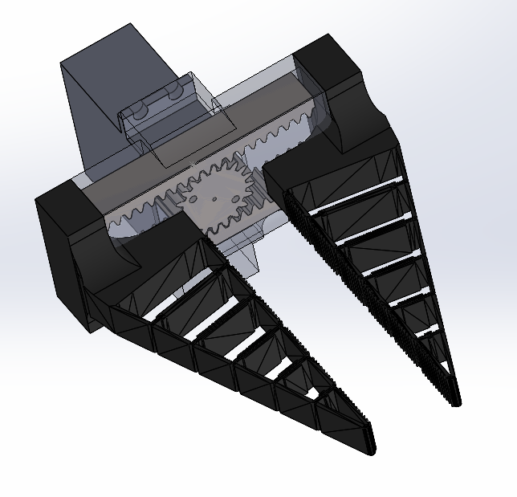
Design Diagram – End Effector
MODEL - 1
MODEL - 2
MODEL - 3

Slide 18
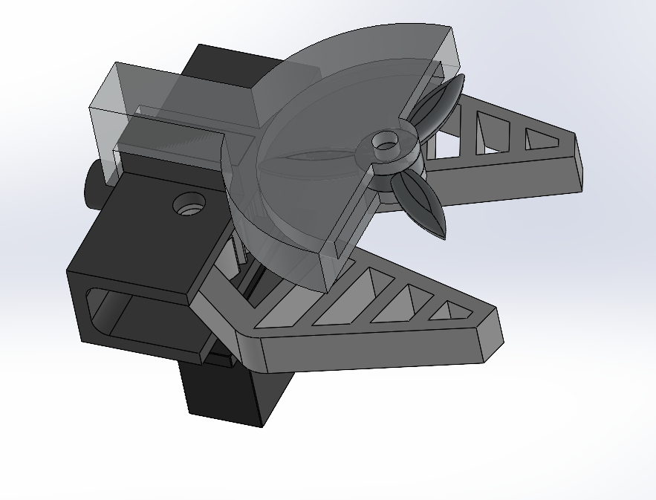
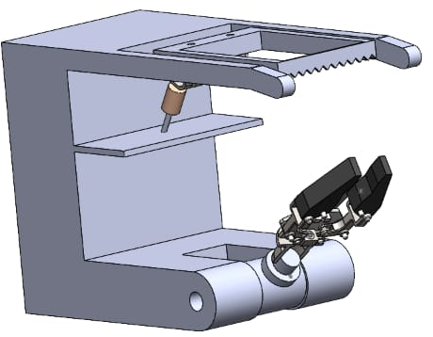
Design Diagram – End Effector
MODEL - 1
MODEL - 2

Slide 19
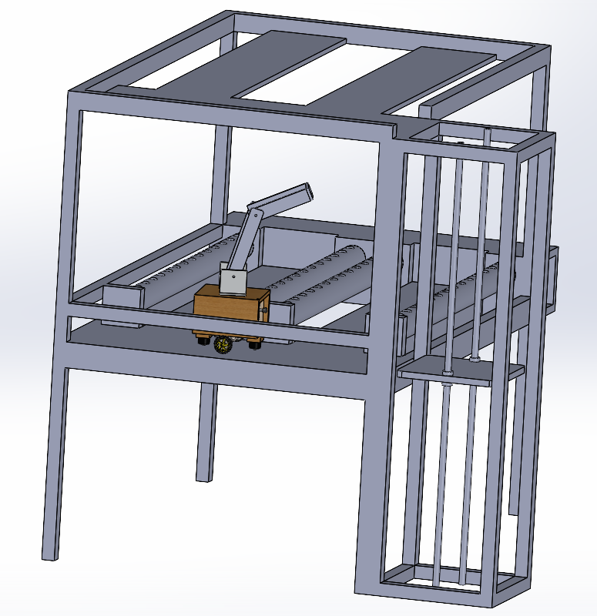
Design Diagram - Table

Slide 20
Methodologies
Most of the recent works in this field focused on the plant growth monitoring and conditioning.
The Closest solution implemented for the same problem is automation with Cartesian manipulators attached to each stack which will be very expensive and complex for maintenance.
Our idea is implementing a Serial mobile manipulator for performing all farming activities such as planting, inspection and harvesting.

Slide 21
Future work plan
Performing required simulations in the virtual farming environment.
Development of required AI/ML algorithms
Fabrication of the Robot and the vertical farm
Control and automation of the robot by implementing developed algorithms in the fabricated model

